Slide 1
Pre-Conference Workshop
NSF Mock Panel Review
V. Celeste Carter
Michael Davis
Connie Della-Piana
Kalyn Owens
Division of Undergraduate Education (DUE)
Education and Human Resources Directorate (EHR)
Hi-TEC 2022, Salt Lake City

Slide 2
Workshop Agenda
Introductions
Name, Institution, Position, Discipline
Part 1: NSF Overview and Merit Review
Part 2: Mock Panel Review Activity
Part 3: Questions/Comments
First Time at HI-TEC?
Served as a Reviewer for NSF?
New to NSF?

Slide 3
National Science Foundation
Overview and Merit Review

Slide 4
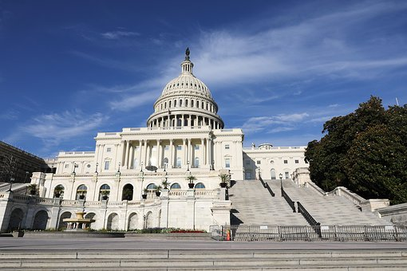
At A Glance
The National Science Foundation (NSF) is an independent federal agency created by Congress in 1950 "to promote the progress of science; to advance the national health, prosperity, and welfare; to secure the national defense..."
Alexandria - 2017

Slide 5
At a Glance
With an annual budget of $8.2 billion, NSF is the funding source for about 24 percent of all federally supported basic research conducted at America's colleges and universities.
93% Funds support research, education and related activities

Slide 6
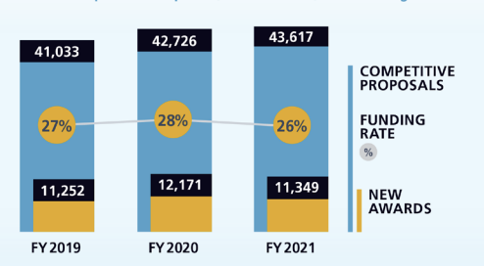
At a Glance
Fiscal year 2021 Activities
43,617 Proposals evaluated
11,349 Awards funded
1,911 NSF-funded institutions
26% Funding rate

Slide 7
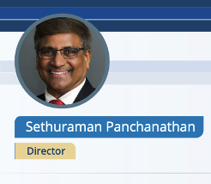
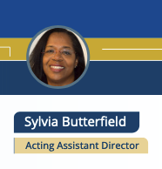
NSF Organizational Chart
Office of Equity and Civil Rights (OECR)
Office of the General Counsel (OGC)
Office of the Director (OD)
NSB National Science Board
Chair, Vice Chair, NSB Executive Officer
Director
Office of Integrative Activities (OIA)
Office of International Science and Engineering (OISE)
Deputy Director
Chief Operating Officer
Chief of Research Facilities
Chief Information Officer
Chief of Research Security, Strategy and Policy
Office of the Inspector General (OIG)
Office of Legislative and Public Affairs (OLPA)
Directorate for Biological Sciences (BIO)
Directorate for Computer and Information Science and Engineering (CISE)
Directorate for STEM Education (EDU)
Directorate for Engineering (ENG)
Directorate for Geosciences (GEO)
Directorate for Education and Human Resources (EHR )
Directorate for Mathematical and Physical Sciences (MPS)
Directorate for Social, Behavioral and Economic Services (SBE)
Directorate for Technology, Innovation and Partnerships (TIP)
Office of Budget, Finance and Award Management (BFA)
Office of Information and Resource Management (OIRM)

Slide 8
Education and Human Resources
EHR supports excellence in U.S. STEM education at all levels, in all settings for the development of a diverse and well-prepared workforce of scientists, technicians, engineers, mathematicians, educators and a well-informed citizenry.
4 Divisions
Division of Undergraduate Education (DUE)
Division of Graduate Education (DGE)
Division on Research and Learning (K-12, Informal Science, DRL)
Division of Human Resource Development (HRD)

Slide 9
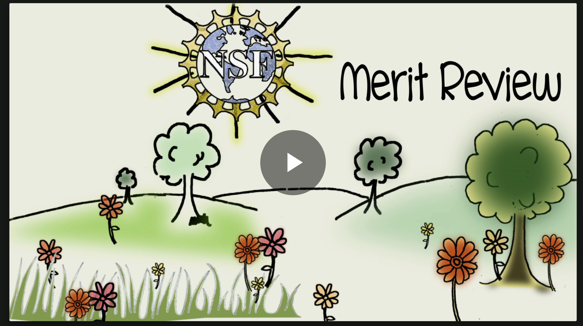
Merit Review Process
How does NSF handle the ~40,000 proposals
submitted each year?

Slide 10
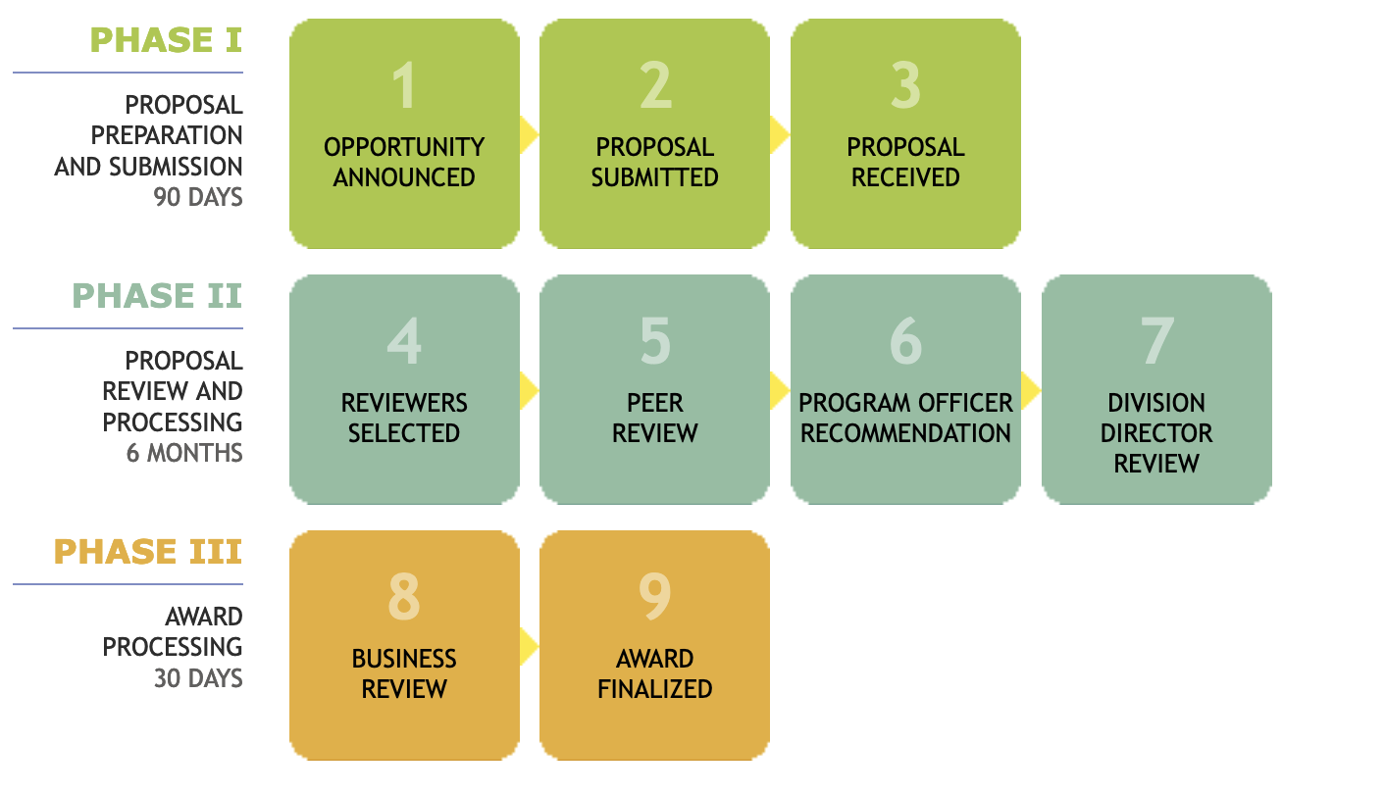
Merit Review Process
https://www.nsf.gov/bfa/dias/policy/merit_review/merit_animation.jsp

Slide 11
Merit Review Facts
All proposals submitted to the NSF are reviewed according the 2 merit review criteria: intellectual merit and broader impacts.
NSF Program Officers make recommendations to award or decline a proposal.
Most proposals that are awarded do not receive all “Excellents”.
NSF Program Officers are encouraged to recommend high risk proposals in STEM.
Principal Investigators submit an average of 2.3 proposals for each one funded.
NSF promotes broadening participation in science and engineering.
https://www.nsf.gov/bfa/dias/policy/merit_review/

Slide 12
Why Volunteer to be a Reviewer?
Reviewers are Essential - NSF needs YOU!
Benefits to you as a reviewer
How to become a reviewer
Contact NSF Now
https://www.nsf.gov/bfa/dias/policy/merit_review/reviewer.jsp

Slide 13
Questions?
V. Celeste Carter: vccarter@nsf.gov
Michael Davis: mdavis@nsf.gov
Connie DellaPiana: cdellapi@nsf.gov
Kalyn Owens: kowens@nsf.gov

