Slide 1
Mock Proposal Review
HI-TEC 2022

Slide 2
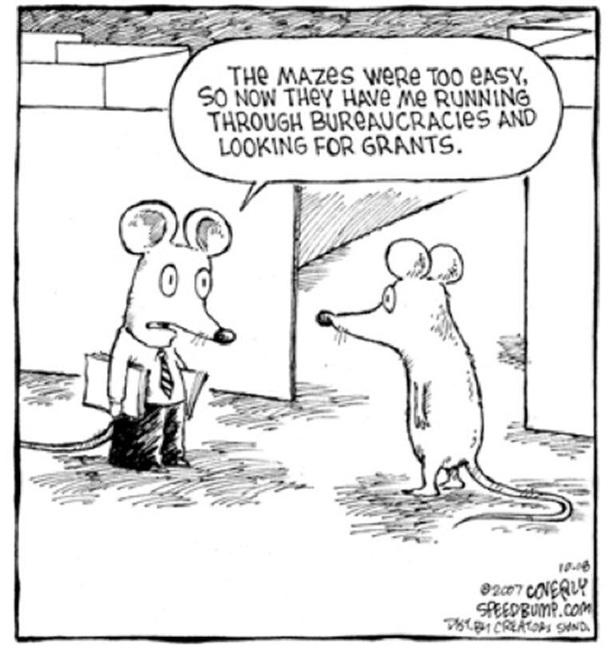
Workshop Agenda
Panel Orientation
Proposal Review
Read Sections
Compare Reviewer and Program Officer Notes
Questions / Comments
Materials:
ATE Sanitized Proposal 2055480

Slide 3
Conflict of Interest (COI)
"If, when we come to consider any particular proposal, you recognize that you have a relationship with the organization or persons involved in the proposal that could be construed as creating a conflict-of-interest, please let me know. I’ll ask you to describe the relationship in your own words and will determine from your description whether you may participate in reviewing the proposal. You must not participate in reviewing any application in which you, your spouse, your minor child, your business partner or any organization of which you are or may become a part has a financial interest."

Slide 4
Common Examples of COI
Conflicts of interest include, but are not limited to, relationships you have with:
An Investigator or Institution
Project Director
Other Person who has a personal interest in the proposal or application (such as an evaluator)
You may have a conflict if you have/hold/are:
Business or professional partnership/collaboration
Other relationship, such as close personal friendship, that may affect your judgment or be seen as doing so by a reasonable person familiar with the relationship

Slide 5
Conflicts of Interest (COIs)
INSTITUTIONAL
current, previous (12 months) or seeking employment
award, honorarium, or travel payment (12 months)
officer or governing board
family member is student
any financial interest
  PERSONAL
  co-author of paper or project collaborator (48 months)
  co-edited journal or proceedings (24 months)
  thesis advisor or student (lifetime)
  family member or close friend
  intuition test: does it feel right?
Notes:
Would your participation undermine faith in the objectivity of the peer review process? Is there an appearance of conflict?

Slide 6
Confidentiality
NSF receives proposals in confidence and protects the confidentiality of their contents.
As a reviewer, you are obligated to maintain the confidentiality of both the proposal you are reviewing and also of your review.
You must not copy, quote from, or otherwise use or disclose (to anyone, including students or postdoctoral or research associates) material from any proposal you are asked to review.

Slide 7
Panel process and results are confidential.
    Do not:
    disclose identities of your fellow reviewers;
    disclose identities of people associated with proposals (PI, Co-PIs, Consultants, etc.);
    use names of other reviewers in reviews or Panel Summaries;
    copy, distribute or quote from proposals;
    identify that you were a reviewer on a specific panel;
    post any panel-related info on social media.
Notes:
Don’t disclose your activities for today on any platform. Within a week of the panel being done you will need to delete your local copies of the proposals.

Slide 8
    Panel process and results are confidential.
    Do:
    Destroy and/or delete any paper or electronic copies of proposals, reviews, panel summary, notes and electronic correspondence or files related to the proposal when you have completed your review;
    You may indicate (e.g., on a resume) that you served on an NSF review panel in a particular calendar year; do NOT mention the program or panel date(s).
Notes:
Don’t disclose your activities for today on any platform. Within a week of the panel being done you will need to delete your local copies of the proposals.

Slide 9
NSF Merit Review Criteria & Summary
Intellectual Merit
The Intellectual Merit criterion encompasses the potential to advance knowledge.
Broader Impacts
The Broader Impacts criterion encompasses the potential to benefit society and contribute to the achievement of specific, desired societal outcomes.
Summary Statement
A summation of the strengths and concerns that provides a rationale for the rating.

Slide 10
Considered for the Review Criteria - NSF
What is the potential for the proposed activity to
  Advance knowledge and understanding within its own field or across different fields (IM); and
  Benefit society or advance desired societal outcomes (BI)?
To what extent do the proposed activities suggest and explore creative, original, or potentially transformative concepts?
Is the plan for carrying out the proposed activities well-reasoned, well-organized, and based on sound rationale? Does the plan incorporate a mechanism to assess success?
How well qualified is the individual, team, or organization to conduct the proposed activities?
Are there adequate resources available to the PI (either at the home organization or through collaborations) to carry out the proposed activities?

Slide 11
What is the Intellectual Merit of the Proposed Activity ? (ATE Specific)
Is the rationale for selecting activities or components for development or adaptation clearly articulated and informed by and build on the research literature and the work of others?
Does the project provide for effective assessment of student learning?
Is the evidence of institutional support clear and compelling, and have plans for long term institutionalization been addressed?

Slide 12
What are the Broader Impacts of the Proposed Activity? (ATE Specific)
Does the project work with employers to address their current and future needs for technicians?
Has an assessment of workforce needs for technicians been conducted?
Will the project evaluation inform others through the communication of results?
Are the results and products of the project likely to be useful at other institutions?
Will the project make it possible for a more diverse pool of students to enter the skilled technical workforce?
Are other educational institutions involved?
Will the project’s results be disseminated and the will the products be distributed effectively when appropriate?

Slide 13
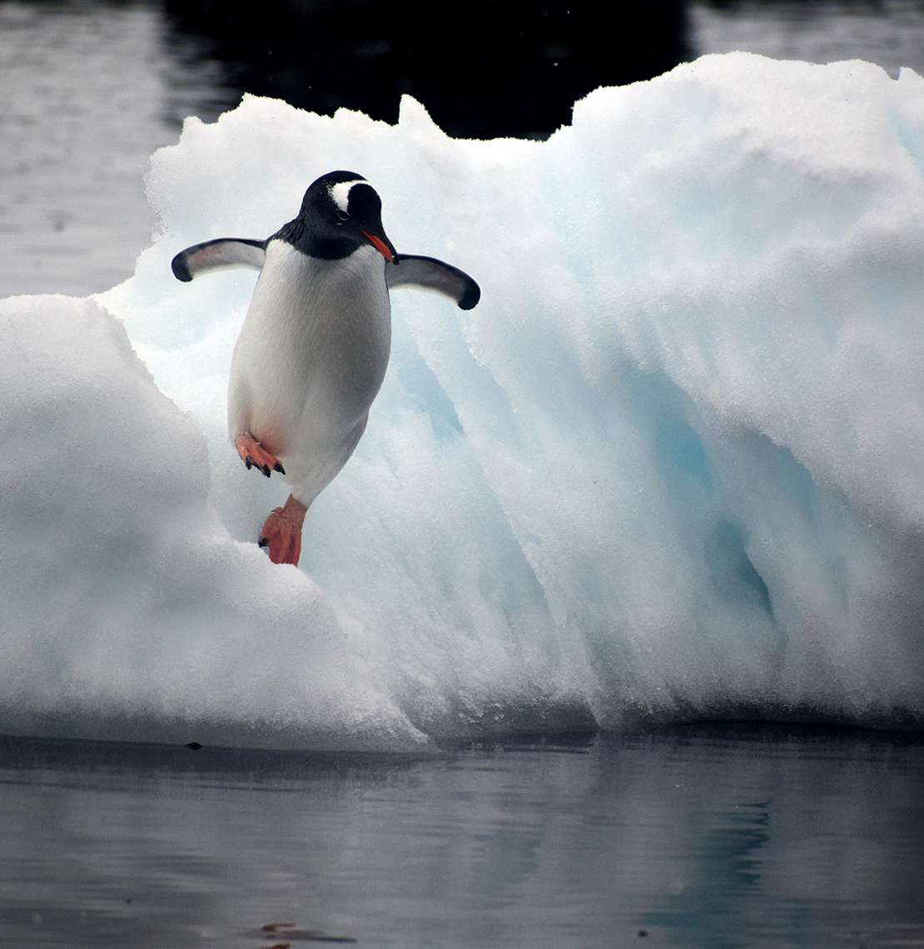


Intellectual Merit and Broader Impacts
Merit Review Criteria Guidance
The previous questions do not constitute a checklist or a rubric.
An individual project does not need to be 50/50 balanced between its Intellectual Merit and Broader Impacts.
ATE supports the implementation of projects that are well-conceived and creative, include the adaption of exemplary resources.

Slide 14
Project Evaluation
Each project should have an evaluator who helps design the evaluation, both formative and summative.
Typically, an evaluation is performed by an independent person/agency (might still be from the same institution e.g., Center for Teaching and Learning).
  Many colleges may have to wait for an award to select an evaluator through a competitive bid process.
An inadequate evaluation plan is not necessarily a fatal flaw; if a proposal is otherwise meritorious, the program officer can negotiate an enhanced evaluation plan.

Slide 15
Typical Format for an Individual Review
Intellectual Merit
General summary of project (2-3 sentences)
Strengths
Concerns
Broader Impacts
Strengths
Concerns
Summary Statement
Overall Strengths
Overall Concerns
Rationale that justifies your rating
Data Management Plan, Post-doc mentoring plan

Slide 16
Provide a Rating for the Proposal
Excellent: an outstanding proposal in all respects. You advise that the proposal be given the highest priority for support.
Very Good: a high-quality proposal in nearly all respects. You advise that the proposal be supported if at all possible.
Good: a quality proposal. You indicate that the proposal is worthy of support.
Fair: the proposal is lacking in one or more critical aspects and/or key issues need to be addressed.
Poor: the proposal has serious deficiencies.
Notes:
In a panel, you will review multiple proposals. Be discerning and supportive! For example, rating all proposals as ‘Good’ does not help the Program Officer or the panel. Although you can assign a split rating, DUE asks reviewers to assign a single rating.

Slide 17
K,W,L Case Approach
K: What I know
W: What I want to know
L: What I have learned
Read the cover page and project summary.
Read Result of Prior Support and Motivating Rationale (Page 1 – 6)
Read Goal to Project Management Plan (Page 6 – 13)
Read Project Evaluation to the End (Page 13 – 15)
Review Additional Documents
Assign a Rating (E, V, G, F, P)

Slide 18
Rating and Ranking
Individual Rating
Excellent
Very Good
Good
Fair
Poor
Panel Ranking - Consensus
Highly Competitive – Should be considered for funding.
Competitive – Should be considered if funds are available.
Not Competitive – Should not be considered, even if funds are available.

Slide 19
Pick an Individual Rating
Individual Rating
Excellent
Very Good
Good
Fair
Poor
Discuss with your panel
Identify a scribe.
Share ratings, and rationale.
Rank the Proposal
Report out.
  Strengths / Concerns

Slide 20
Comparisons to the Panel - Strengths
Intellectual Merit
Strong need for an educated workforce.
2+2+2 model effective in attracting and retaining students.
Proposed programs are needed in geographical area.
Good industrial advisory board.
Commitments from administrators, MNT-EC, MANCEF
Strong PI team.
Evaluation plans are satisfactory.
Broader Impacts
Taking place at an HBCU
Potential for impact on regional industry.
Supports students entering high-wage jobs.

Slide 21
Comparison to the Panel -Concerns
Intellectual Merit
Not clear that a program in any of the three areas currently exists. Need detail on the content of the three tracks in the program.
The PI team lacks experience in either process or industrial
technology.
Need detail on certifications and participation by high schools.
Need local economic data.
Broader Impacts
Detail needed on recruitment of women to programs.
Detail needed on time to completion via a 2+2+2 pathway
Detail needed on job opportunities open to dual-credit high school students

Slide 22
Questions from the Program Officer
Project
Please provide the specific high schools that will be engaged, the number of teachers and faculty, and the credentials students will earn.
Goal of attracting women, but did not appear to have many women involved in the project.
Details about who would be leading in the industrial engineering or process engineering pathways.

Slide 23
Questions from the Program Officer
Budget
Webinars mentioned, but not adequately described.
Used a lower indirect cost. Not allowed.
Money given to students, but did not describe how or what for?

Slide 24
Writing a Proposal: Getting Started
Start
Start EARLY (6 months)
Get
Get acquainted with research.gov (FastLane is sunsetting)
Read
Read the Program Solicitation and follow the guidelines. Read the Proposal & Award Policies & Procedures Guide (PAPPG)
Learn about
Learn about the recent DUE awards using the NSF Award Search tool
Become
Become an NSF reviewer
Contact
Contact (e-mail is best) a program officer to discuss your idea. This may cause you to refine your idea and may prevent you from applying to the wrong program
Program
Program Officers in DUE: Check the solicitations for names and contact information

Slide 25
Compliance Check
Number of pages, formatting, font size
Completeness
  READ the Program Solicitation and the Proposal & Award Policies & Procedures Guide (PAPPG) (new guidelines!)
  Data management plan, enforcement of submission deadline
  Automated compliance checks in effect including time of submission (5:01pm gets RWR).
  Additional materials (appendices) can result in a Return Without Review.

Slide 26

What Works?
Describe a need.
Provide a detailed plan for how you will address the need.
Include the evidence base for your plan.
Include project personnel with the appropriate expertise to carry out the project.
Provide an evaluation and assessment plan that allows you to know how successful the project might be.
What evidence have you generated and how has it been analyzed?
Describe how you will disseminate the results and outcomes of the project
  Inform the community of the knowledge gained. (Accountability and transparency)

Slide 27
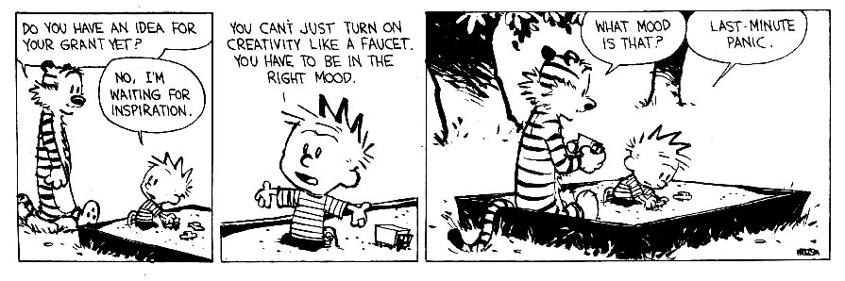
In Summary
Read the solicitation.
Read the PAPPG.
Contact your colleagues.
Contact a Program Officer.

